Slide 1



Hardware and Software Fundamentals of Intelligent Computing Systems
Notes:
需要涉及的要点：
- 第一课时：Compute Architectures 的逐渐演化：由AI/ML workload 引导，逐渐展示出多种多样的架构，如华为达芬奇、AMD等等
- 第二课时：互联的硬件基础，与CUDA core、Tensor core 的编程。
- 可能还需要涉及的点：课程整体设计（Syllabus、各个模块的内容，根据教学大纲生成了个overview的图）

Slide 2
Lecture 08: Memory Hierarchy Optimization
Shared Memory & Cache Optimization Techniques
GPU Memory Hierarchy
Shared Memory
Memory Hierarchy Overview
Optimization Strategies
Bank Conflict
Reduction Kernel
Bank Conflicts and Solutions
Reduction Kernel Optimization
Notes:
配图建议：GPU Memory Hierarchy 总图（CUDA官方图）

Slide 3
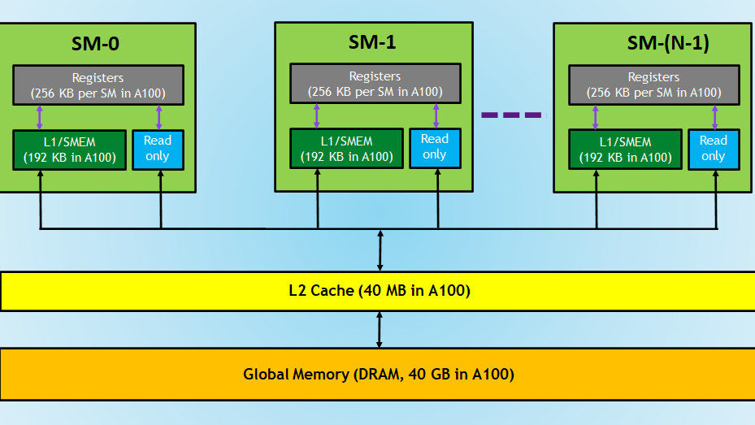
GPU Memory Hierarchy Overview
Memory Structure (Fastest to Slowest)
Speed Difference
100×
1
Register
Fastest, private to each thread
Register vs Global Memory
2
Shared Memory
Up to 100× performance gap
High-speed memory inside SM
3
L1 Cache
L1 Cache
4
L2 Cache
L2 Cache
5
Global Memory
Slowest, largest capacity
NVIDIA Developer Blog
Notes:
单击此处添加文本

Slide 4
Register
Register Characteristics
Fastest storage
Located inside GPU cores, extremely fast access
Private to each thread
Register per Thread
Not visible between threads, ensures data independence
R0
R1
R2
R3
Small capacity
Example: 64 KB per SM
R4
R5
R6
R7
Primary Uses
R8
R9
R10
R11
Local variables
Temporary results
Each thread has its own independent set of registers
Store temporary computation results
Cache intermediate computation data
Register per thread diagram
Notes:
单击此处添加文本

Slide 5
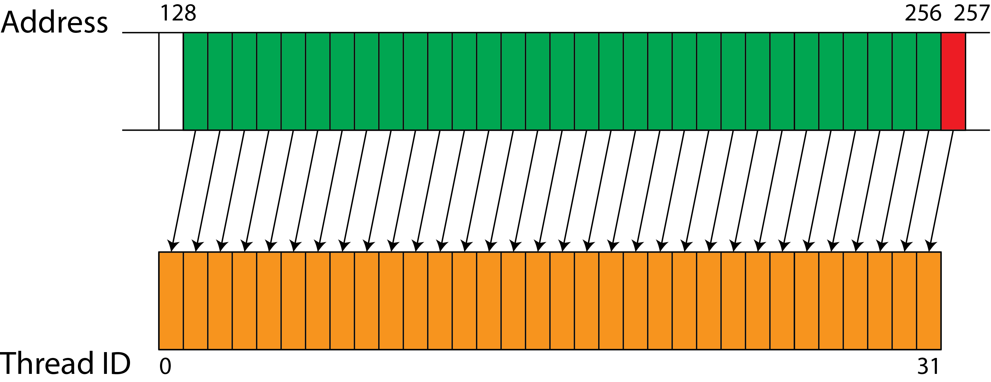
Global Memory
Global Memory Characteristics
Large capacity
GB-scale, can store large amounts of data
High latency
400-800 cycles
Accessible by all threads
Globally visible, shared across threads
Main Problem
Slow access speed
High latency becomes a performance bottleneck
Optimization Goal
400-800
Reduce Global Memory accesses
cycles latency
Image source: POP CoE
Notes:
单击此处添加文本

Slide 6
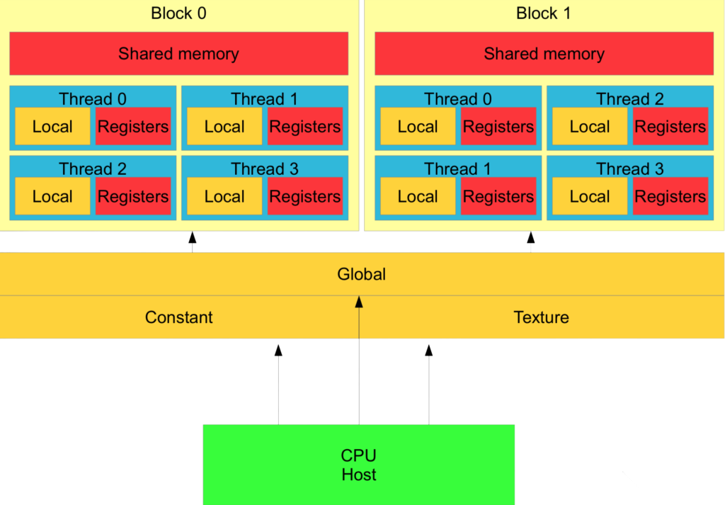
Shared Memory Concepts
Shared Memory
High-speed memory inside the SM
Key Characteristics
Low latency
~20 cycles, 20–40× faster than Global Memory
Shared within a block
Threads within the same block can share access
Limited capacity
Example: 48 KB per SM
~20
48KB
cycles
per SM
Image source: The Beard Sage
Notes:
单击此处添加文本

Slide 7
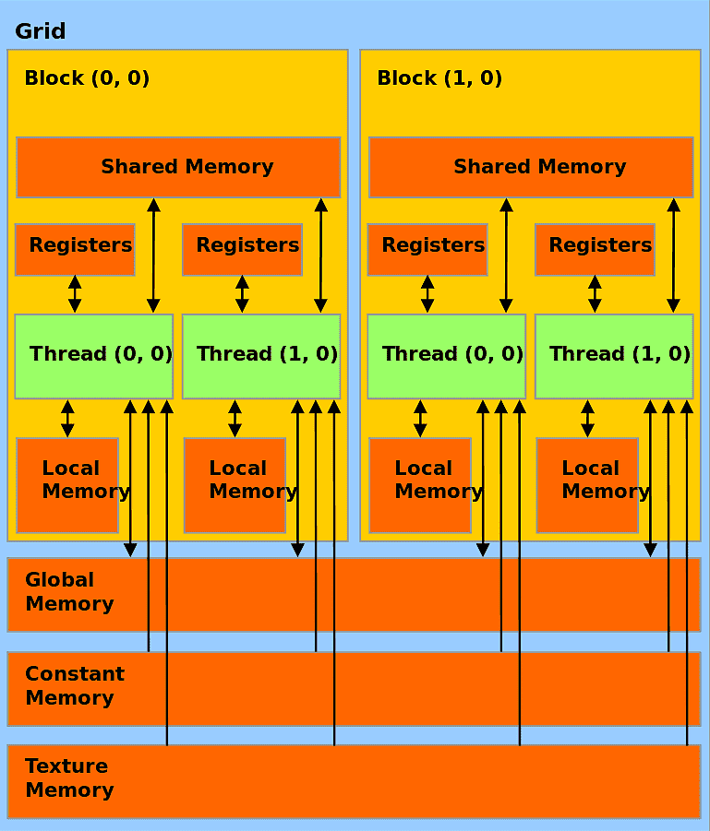
Why Shared Memory is Faster
Global Memory
Far from compute units
High-latency access
Large capacity but slow
Shared Memory
Inside the SM
Physically close, faster access
Similar to CPU cache
Key Insight
Physical location determines access speed
Speed Comparison
400-800
vs
~20
Global
Shared
cycles
Image source: SLING Documentation
Notes:
单击此处添加文本

Slide 8
Shared Memory Usage Example
CUDA Example Code
Primary Uses
// Declare Shared Memory
__shared__ float tile[32][32];
// Use inside the kernel function
__global__ void kernel(float* input, float* output) {
// Get thread indices
int tx = threadIdx.x;
int ty = threadIdx.y;
// Load data from Global Memory to Shared Memory
tile[ty][tx] = input[...];
// Sync threads to ensure data is loaded
__syncthreads();
// Compute using data in Shared Memory
float result = tile[ty][tx] * 2.0f;
// Write back to Global Memory
output[...] = result;
}
Cache data
Temporarily store frequently accessed data
Reduce global memory accesses
Reduce memory bandwidth pressure
Keywords
__shared__
Declare shared memory
__syncthreads()
Thread synchronization
Notes:
代码示例：CUDA Shared Memory 声明与使用

Slide 9
Shared Memory Optimization Principle
Naive Approach
Optimized Approach
Read from global memory every time
global → shared memory
High latency, poor performance
shared memory → register
Frequent global memory accesses
Reduce global memory accesses
Memory Access Flow Comparison
Naive
Optimized
Global Memory
Global Memory
↓
↓
Register
Shared Memory
↓
↓
Global Memory
Register
Notes:
配图建议：memory access flow 图

Slide 10
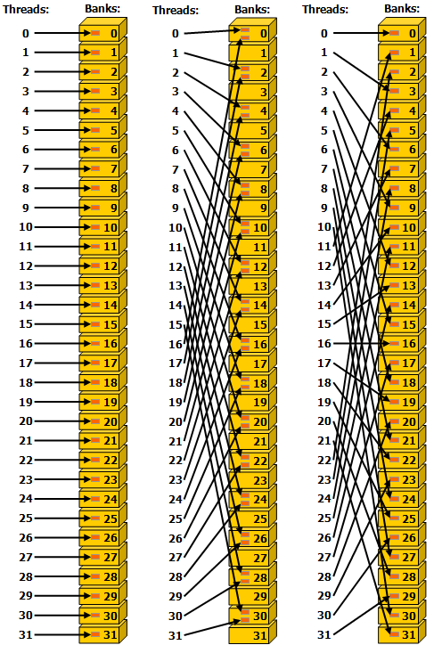
Bank Structure Introduction
Shared Memory is divided into multiple Banks
Key structure enabling parallel access
Bank Characteristics
Multiple Banks
Example: 32 banks
Each bank can be accessed independently
Different banks can be accessed simultaneously
Bank Conflict
Simultaneous access to the same bank causes a conflict
32
banks (typical configuration)
Image source: Lei Mao's Log Book
Notes:
单击此处添加文本

Slide 11
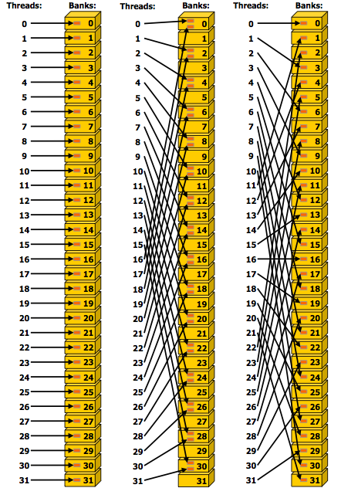
Bank Conflict Definition
Bank Conflict
Shared Memory Performance Killer
Problem Definition
Multiple threads simultaneously access
the same bank
Causes access to be serialized
Cannot execute in parallel
Severe performance degradation
Loses the parallel advantage
N
1
N×
threads
bank
slower
Image source: UIC Mathematics
Notes:
单击此处添加文本

Slide 12
No Bank Conflict Case
Ideal Case
Each thread accesses a different bank
Access Pattern
thread 0
→
bank 0
thread 1
→
bank 1
thread 2
→
bank 2
thread 3
→
bank 3
Parallel access
Maximum performance
Notes:
图片来源：NVIDIA Developer Forums

Slide 13
Bank Conflict
Conflict Case
Multiple threads access the same bank
Access Pattern
thread 0
→
bank 0
thread 1
→
bank 0
thread 2
→
bank 0
thread 3
→
bank 0
Serialized execution
Performance degraded
Image source: Lei Mao's Log Book
Notes:
单击此处添加文本

Slide 14
How to Avoid Bank Conflicts
Padding Method
How It Works
Avoid conflicts by adding padding
Original array
tile[32][32]
32 elements per row, aligned to 32 banks
Code Example
After padding
// Original declaration (may cause bank conflict)
__shared__ float tile[32][32];
// After padding (avoids bank conflict)
__shared__ float tile[32][33];
// Explanation:
// Original: 32 floats per row, exactly occupying 32 banks
// Result: elements in the same column share the same bank
//
// Padding: 33 floats per row
// Result: elements in the same column are spread across different banks
tile[32][33]
33 elements per row, staggering the bank distribution
Effect
Elements in the same column are distributed across different banks
Key Technique
Adding one column of padding is enough to avoid conflicts
Notes:
配图建议：padding 避免 conflict 图

Slide 15
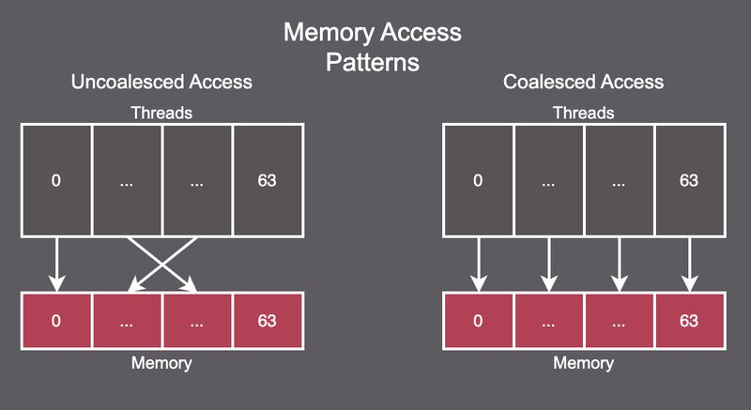
Memory Coalescing Concept
Coalesced Access
Key to Global Memory Optimization
Definition
Consecutive threads
Adjacent threads
access contiguous addresses
Contiguous memory addresses
Maximum efficiency
Merged into a single memory transaction
Example
thread i
→
A[i]
Consecutive threads accessing contiguous addresses
Image source: LinkedIn - Mayur Jain
Notes:
单击此处添加文本

Slide 16
Non-coalesced Access Problem
Incorrect access pattern
Causes severe performance degradation
Problem Example
thread 0
→
A[0]
thread 1
→
A[1000]
thread 2
→
A[2000]
Stride
Causes
1000
Multiple memory transactions
Severe performance degradation
Image source: POP CoE
Notes:
单击此处添加文本

Slide 17
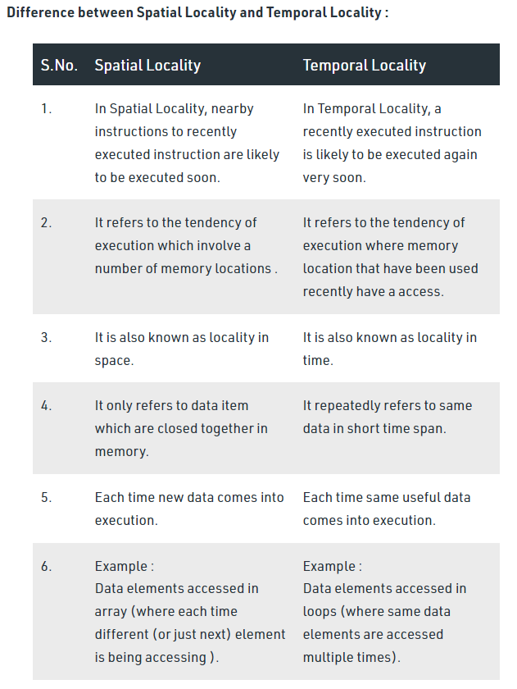
Cache Locality
Two Types of Locality
Key to improving cache hit rate
Temporal
Spatial
Repeatedly accessing the same data
Accessing nearby data
Temporal Locality
Spatial Locality
Example: variables reused in a loop
Example: sequentially accessing array elements
Optimization Goal
Improve cache hit rate
Image source: Medium - InterviewNoodle
Notes:
单击此处添加文本

Slide 18
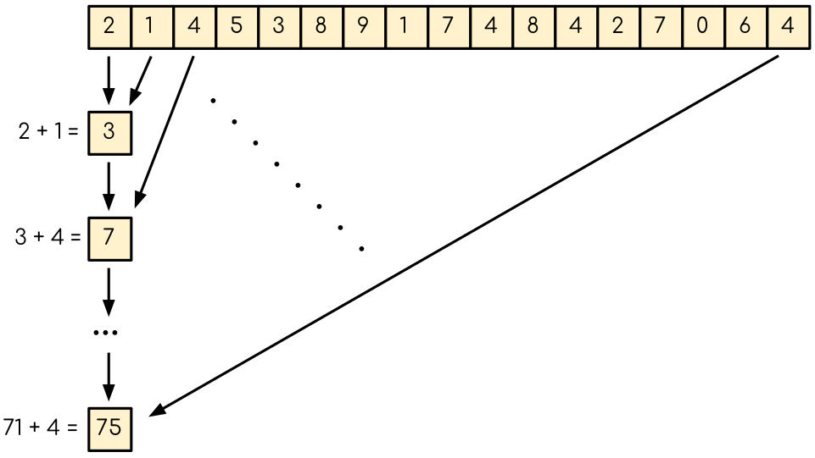
Reduction Kernel Problem Definition
Reduction Example
Compute the sum of array elements
Problem Definition
Compute: sum(A)
Input: array A
Output: A[0] + A[1] + ... + A[n-1]
Problems with the Naive Approach
Each thread writes to global memory
Frequent global memory accesses
Reduction Operation
Excessive memory accesses
A[0] ⊕ A[1] ⊕ A[2] ⊕ ... ⊕ A[n-1]
Becomes a performance bottleneck
⊕ can be +, ×, max, min, etc.
Image source: ENCCS CUDA Training
Notes:
单击此处添加文本

Slide 19
Optimizing Reduction with Shared Memory
1
Load data
2
Reduction computation
3
Write back result
global → shared memory
reduction within shared memory
Final write to global memory
Optimization Flow
Global Memory
Shared Memory
Global Memory
→
→
Input Data
Load & Reduce
Output Result
Input Data
Load & Reduce
Output Result
Optimization Advantage
Reduces global memory accesses and improves parallel efficiency
Notes:
配图建议：reduction shared memory 图

Slide 20
Reduction Kernel Example
CUDA Implementation Code
Code Notes
__global__ void reduction_kernel(float* input, float* output, int n) {
// Declare Shared Memory
__shared__ float sdata[256];
// Get thread indices
int tid = threadIdx.x;
int i = blockIdx.x * blockDim.x + threadIdx.x;
// Load data from Global Memory to Shared Memory
sdata[tid] = (i < n) ? input[i] : 0;
// Sync threads to ensure data is loaded
__syncthreads();
// Perform reduction in Shared Memory
for(int s = blockDim.x/2; s > 0; s >>= 1) {
if(tid < s) {
sdata[tid] += sdata[tid + s];
}
__syncthreads();
}
// Write result back to Global Memory
if(tid == 0) {
output[blockIdx.x] = sdata[0];
}
}
Declare shared memory
__shared__ float sdata[256]
Load data
global → shared memory
Thread synchronization
__syncthreads()
Reduction loop
Halving reduction strategy
Code example: CUDA Reduction Kernel implementation
Notes:
单击此处添加文本

Slide 21
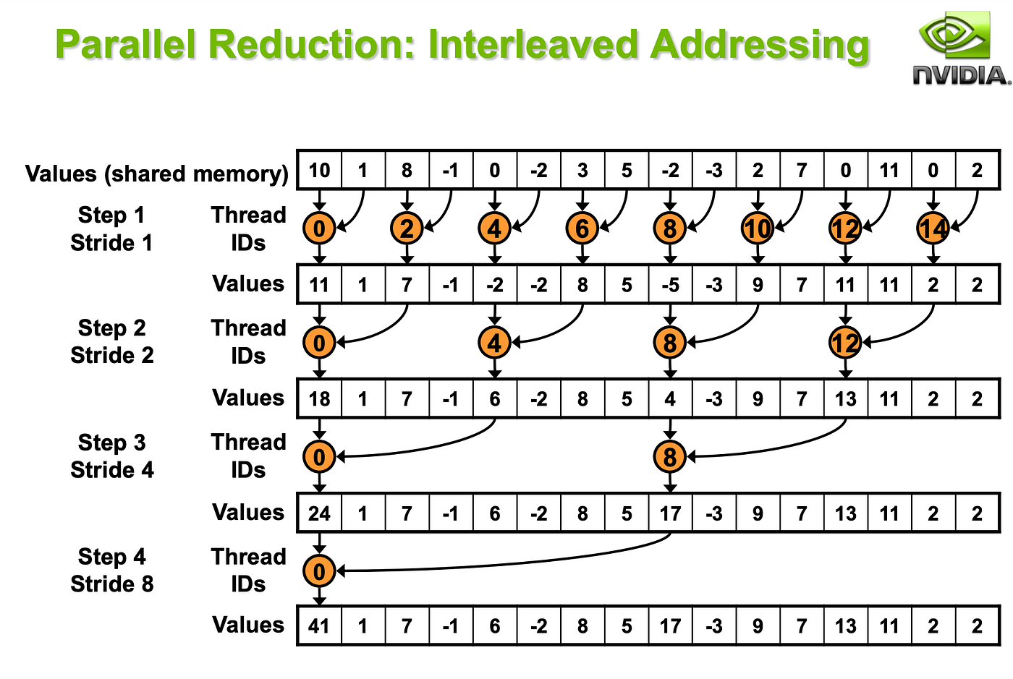
Optimization Effect Comparison
Naive
Optimized
Slow
Fast
Frequent global memory accesses
Using shared memory
Performance improvement
10-50×
Performance improvement
Reasons for Improvement
Reduced global memory access
Improved parallel efficiency
Fully leverages shared memory's low latency
Image source: Medium - Rimika Dhara
Notes:
单击此处添加文本

Slide 22
Resources
Advanced Topics
Recommended Resources
Matrix Multiplication (MatMul)
Official Docs
Learn shared memory and tiled computation
https://triton-lang.org/main/index.html
Softmax
Understand reduction operations and numerical stability
Official Tutorials
LayerNorm
https://triton-lang.org/main/getting-started/tutorials/
Learn statistics computation and broadcast operations
GitHub Repository
Flash Attention
https://github.com/triton-lang/triton
Advanced memory optimization and kernel fusion
Start Your Triton Journey!
Starting from Vector Add, explore the limitless possibilities of GPU programming
Image source: Triton Official Docs
Notes:
单击此处添加文本

Slide 23

The Solution: FlagOS, a Unified AI Software Stack

Slide 24








https://space.bilibili.com/3546791834290849
https://github.com/flagos-ai
https://www.zhihu.com/people/95-22-20-18/posts
https://flagos.io/Home

Slide 25

Thanks for your time！

